Slide 1
Copy Number Variation
Structure of larger variant calling

Slide 2
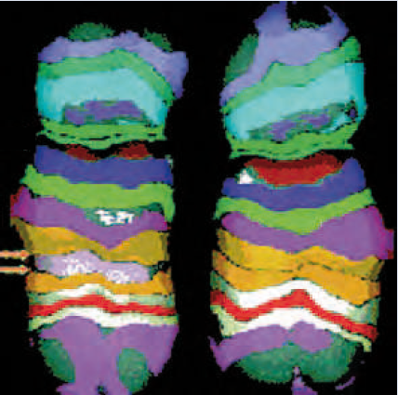
Definition
“Refers to the genetic trait involving the number of copies of a particular gene present in the genome of an individual. Genetic variants, including insertions, deletions, and duplications of segments of DNA.”
- NATIONAL CANCER INSTITUTE
“The use of multicolor FISH (mFISH) revealed that a segment within normal human Chromosome 5 (paired arrows, left) has been deleted (an interstitial deletion, right) following extensive exposure to radiation from plutonium.”
- The Biology of Cancer, Robert A. Weinberg

Slide 3
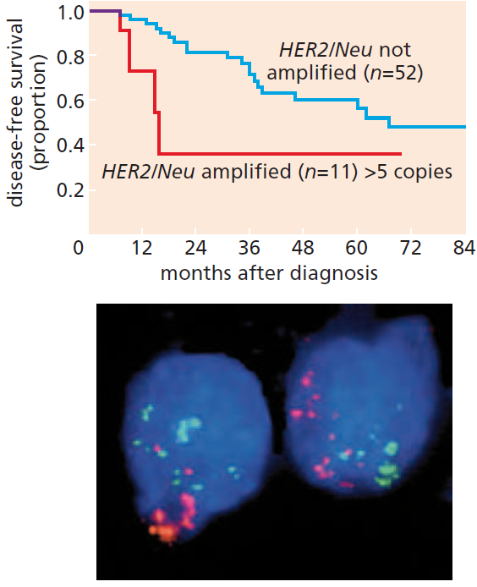
Gene Amplification
Amplification of the erbB2/HER2/neu oncogene in breast cancers
More copies resulted in poor prognosis
The inverse correlation between erbB2/HER2 expression levels and long-term patient survival provided a strong indication that this gene, in amplified form, was causally involved in driving the malignant growth of the breast cancer cells.
Multiple sites of erbB2/HER2(light green) and CCND1/cyclin D1 (orange/pink) - The Biology of Cancer, Robert A. Weinberg

Slide 4
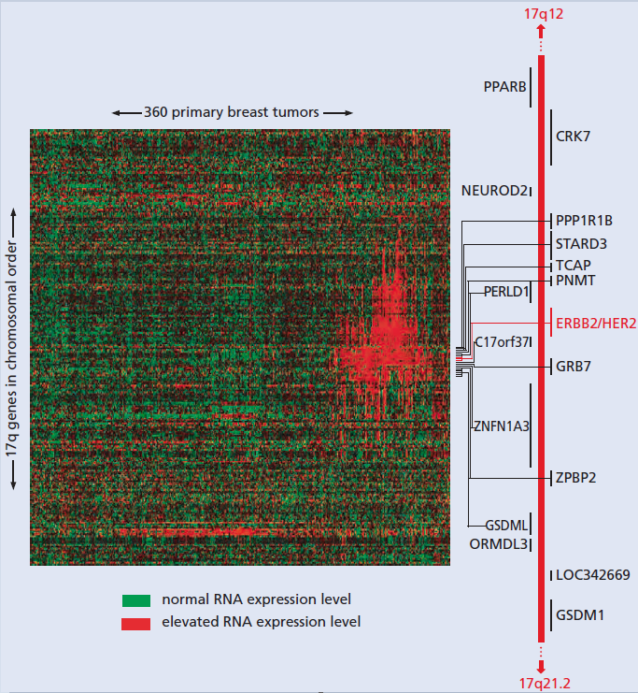
Gene Amplification
Expression levels of a cohort of 160 genes that flank ErbB2/HER2 for 360 human breast cancers.
Amplicons included a stretch of chromosomal DNA than the gene, resulting in co-amplification of neighboring genes that may be collaborating to orchestrate the malignant phenotype of human breast cancer cells, and it becomes difficult to ascribe specific cancer cell phenotypes to the elevated expression of only a single gene.

Slide 5
Gene Amplification
The map of some of the genes identified that flank HER2 on both sides is provided (red vertical bar, right).
Probes for 160 distinct genes in this chromosomal region were arrayed in the order of their location along human Chromosome 17q.

